Slide 1

FY26 Commercial Marketing Planning
Campaign Brief Template:
Campaign Name
Campaign GMPM:
Campaign GMS:
Revision Date:
Campaign Code:
Campaign Brief Approvals
Stakeholder Partner: name and date
GMPM Director: name and date
GMS Director/Manager: name and date

Slide 2
Insert Campaign Name Here Overview – Business and Customer
Strategic Theme | Program
Situation, Campaign Focus
What’s the current situation? i.e. a challenge we’re looking to solve, the current industry climate, a new breakthrough, recent trends.
Business Goals: “What does success look like”
Customer: “Who are they, and what success looks like for them”
Who are we talking to? e.g. define the audience, their roles/positions, their goals/initiatives, what success looks like to them, what are their needs, our solution, what do they know and think about us, our rivals and the market? e.g. where is the ‘sweet spot’ of opportunity (is this top 40 accounts, a long tail of small dispersed accounts, accounts embedded with the competition…) What is our solution? How does it meet the customer needs? (See Value Proposition in Appendix)
Customer Value: “How do we address the customer needs?”
What’s the customer insight statement? i.e. the one, single, most compelling message we need to convey. How can we prove our message? e.g. the facts that back up our argument, the key points we need to cover. Who’s the competition? e.g. how they’re different/what is their competitive threat and what campaigns they’re running/messaging/marketing promise.

Slide 3
Insert Campaign Name Here Overview
Campaign Goals: “Why are we doing this”
I.e. what is it that we ultimately want to achieve? These tend to be long-term outcomes e.g. drive awareness to interest, change perception, become the market leader, achieve RTV targets…. What are the Customer Journey stages we are targeting? i.e. Aware > Interest > Decide > Onboard > Use > Support > Renew
Campaign Objectives: “What are the SMART measures of success”
I.e. what are the specific measurable steps that make the goals actionable? e.g. Generate 500 qualified leads in Q1, Achieve 10% growth in XX solution sales by end of fiscal
Campaign Timing:
Campaign Strategy: “High-level approach to achieve the objective”
I.e. Overarching guidance for how we can achieve the campaign objectives. Include the customer journey stage we are targeting. (Aware > Interest > Decide > Onboard > Use > Support > Renew)
Localization / Regionalization Strategy:
Campaign Budget:
Q1 | Q2 | Q3 | Q4 | Annual:
Customer Stage | Target Market | Target Application | Target PL | Target Product | Target persona

Slide 4
Appendix
Supporting information and tools

Slide 5
Target Persona Framework
Products/Solution
Workflow
Regions
AFO
EMEA
Markets
China
APAC
Organization Size
Application (if applicable)
Large
Account
Medium
Small
Active
Competitive
Prospect/
Dormant
Value Chain (if applicable)
Target Persona: (Full title of Target Persona)
Option for multiple products/workflow/ regional focus
Choose one workshop persona for each
Option for multiple org size/account
Provide complete Buyer Group - choose one priority persona for workshop
Workshop Persona (Biggest Opportunity)
Decision Maker (makes final purchasing decision) | Influencer (sway decision making process) | Champion (biggest advocates) | Gatekeepers (control access to purchasing) | User (use the solution and provide feedback)
Target at later time
Not planned
Link to Agilent Target Personas
Notes:
Additional Considerations:

Slide 6
Product/Solution Value Proposition, Differentiators
Value proposition (provided by Product/Segment Marketing)
For: Who: Our product(s): Provides: Unlike: Our solution: Key message / SNI:
Agilent Differentiators (Exclusive, Matters, Demonstrated)
September 2023 AGILENT HIGHLY CONFIDENTIAL FY24 Campaign Strategy & Content Ecosystem, Tier 1
Notes:
Input provided by Product Management or Segment Marketing lead.
Differentiators focus on top 2-3, and should be pulled directly from the messaging workshop templates

Slide 7
Customer Insight
Provide Insight: Prove understanding
& introduce overlooked issue
Motivate Action: Reveal adverse impacts & researched proof
Solve Issue: Demonstrate that only Agilent can solve the issue
.
Goals
Adverse Impact
Value-First
Trends
Differentiators & Benefits
Logical Impact (Research)
Overlooked Issue

Slide 8



Story Arc
Setup Introduce target persona, setting, and context. Establishes the initial situation and hint at the main conflict | Confrontation Present the main conflict and obstacles. Intensifies the challenge, creating tension and pushing characters to find solutions. | Resolution Concludes the story by resolving the challenges. Provides closure and shows outcomes.

Slide 9
Transition Framework: Customer Insight > Messaging > Creative
1. Overarching Message (Goals, Trends/Challenges, Value-First) Identify customer’s goals and trend-driven challenges to determine the high-level value your solution offers to help customers succeed.
2. Aware (Overlooked Issue & Adverse Impact) Disrupt: Expose a critical, often - overlooked problem and the pain of inaction | 3. Interest (Value-First) Solve: Reveal the tangible value of our solution to overcome the identified pain points | 4. Decide (Differentiators & Benefits) Prove: Demonstrate how our unique capabilities and benefits deliver real, meaningful results
5. Logical Impact implemented across the customer journey
“I didn’t realize this was a problem or a solvable problem.” | “What is the true value in solving this problem?” | “How are you going to help me solve the problem?”
Customer Insight
Customer
Thought
Notes:
Instructions:
Translate the full customer insight statement into a concise, focused message within each numbered section:
Use short, clear statements (one sentence or phrase) that reveal:
1. High-level Value
2. Critical Problem
3. Tangible Value
4. Unique Capability
5. Evidence
Messaging Check: Does it satisfy these customer thoughts?

Slide 10
Content Audit Existing content to support content strategy
Content | Content Type | Updates needed? | Links
Notes:
Instructions:
Include existing content relevant to this campaign that could be used as-is or updated/ re-worked to fit campaign needs.

Slide 11
Content Blueprint
Level of Difficulty
Easy | Medium | Difficult
1 – 4 | 5 – 7 | 8 – 10
Priority
Low | Medium | High
Any time | Prefer by launch, or soon after | Must have prior to launch
Campaign Name
Driving Customer to Embrace the Insight What major issues are they overlooking, not recognizing impact, or misunderstanding?
STOP: Customer Perspective | START: Desired Customer Understanding | Content | Potential Asset(s)/ Asset Type(s) | Status (New or Existing-Needs Update) | Level of Difficulty | Priority
Confronting Customer Arguments What objections or misconceptions do they have about the Customer Insight?
Notes:
Instructions:
Only include the content that will be created for this campaign.
Keep the original Content Blueprint as reference for future campaigns and/or messaging.

Slide 12

Making TEA from the Blueprint
Level of Difficulty
Easy | Medium | Difficult
1 – 4 | 5 – 7 | 8 – 10
Priority
Low | Medium | High
Any time | Prefer by launch, or soon after | Must have prior to launch
Campaign Name
STOP: Key Customer Perspective | START: Desired Customer Understanding | Content | Potential Asset/Asset Type | Trigger | Educate | Affect
Notes:
Instructions:
Only include the TEA content that will be created for this campaign.
Key customer perspectives used in TEA are typically important to the campaign.
If all of TEA items are not used, keep the original as reference for future campaigns and/or messaging.

Slide 13
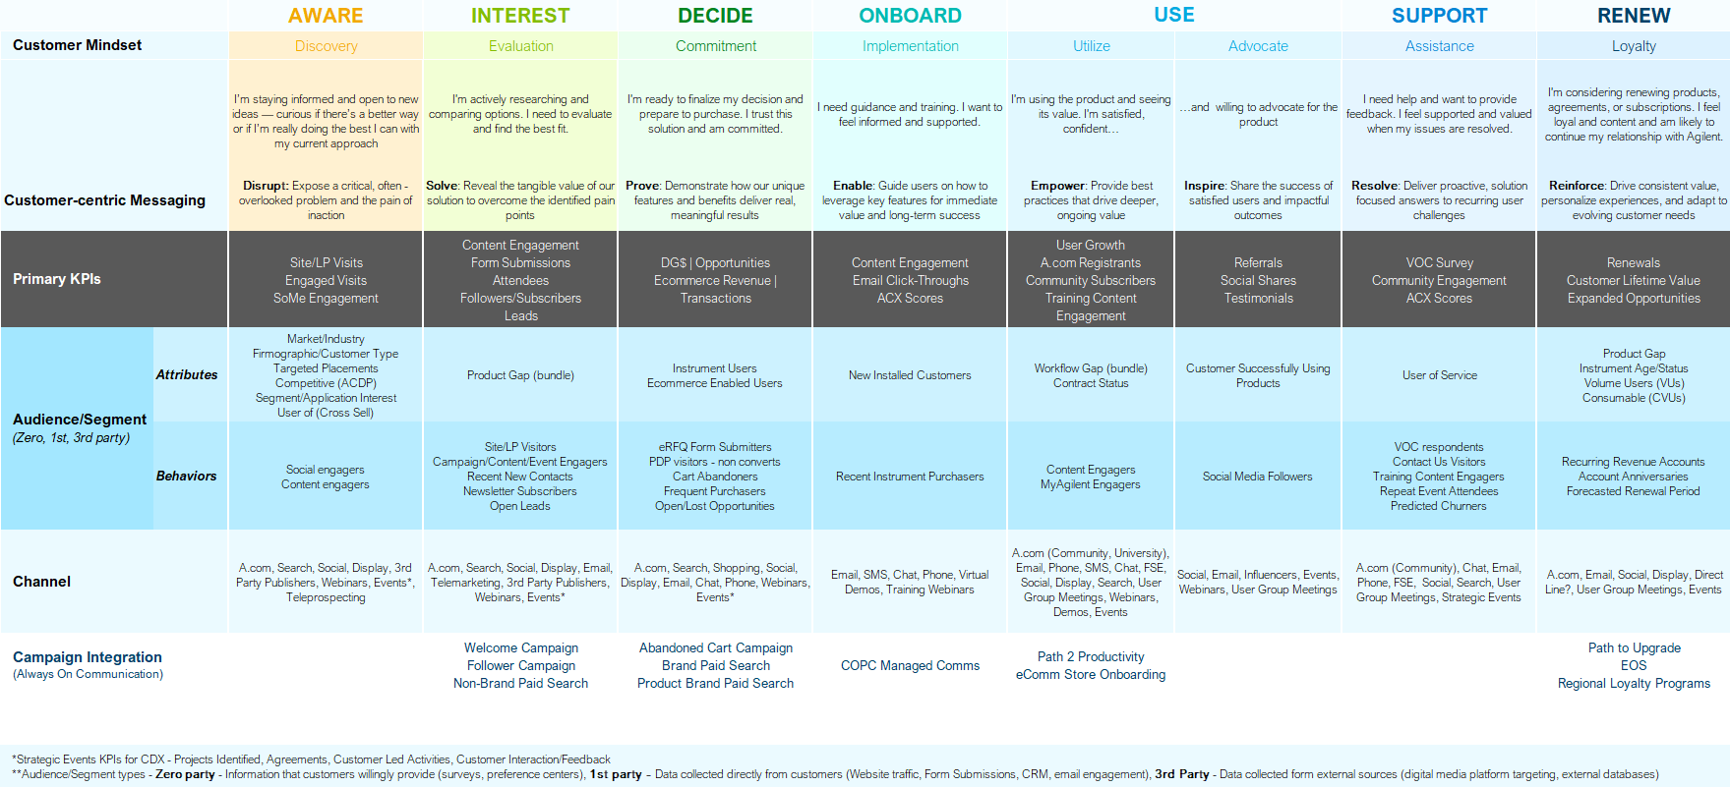
Customer Centric Marketing Framework
Guide for targeted campaign development or integration based on customer stage
Smart Start Series
Shopping/Product Listings

Slide 14
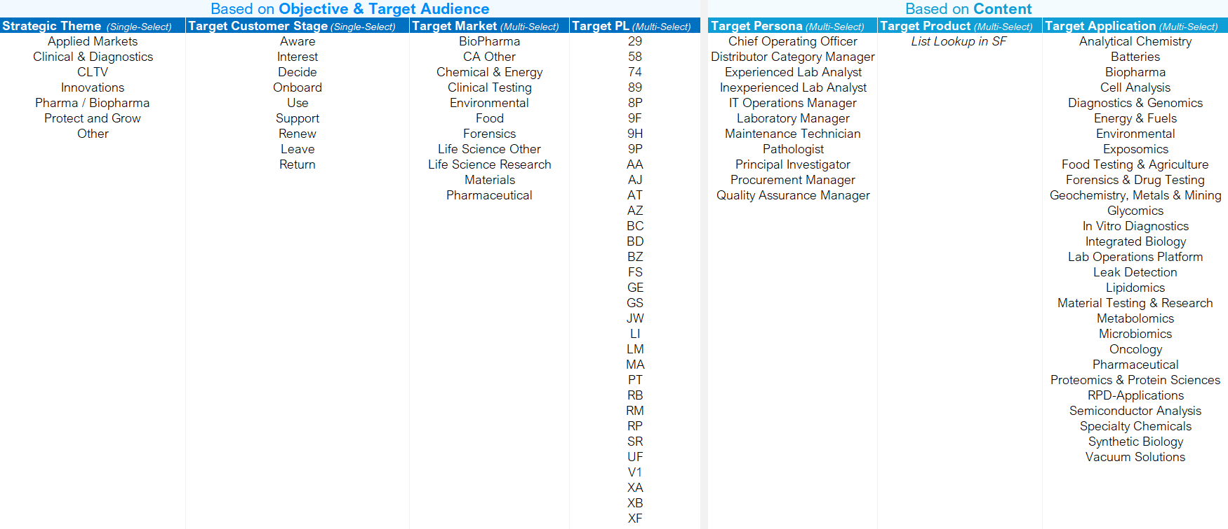
Campaign Brief Field Values Aligned with Salesforce CRM Campaign Object field selections

